Slide 1

Angle-Based Codebook for Low-Resolution Hybrid Precoding in Millimeter-Wave Massive MIMO Systems
Jingbo Tan, Linglong Dai, Jianjun Li, Shi Jin
Tsinghua National Laboratory for Information Science and Technology (TNList)
Department of Electronic Engineering, Tsinghua University, Beijing, China
2018-4-23
Notes:
Hello，everyone, the title of my presentation today is Angle-based Codebook for Low-Resolution Hybrid Precoding in Millimeter-Wave Systems. We design an angle-based codebook for low-resolution hybrid precoding, where the analog codebook is designed based on channel path angles. Under the observation that the channel vectors consists of slow-varying path angles and fast-varying path gains, the analog precoder selected from angle-based codebook can remain unchanged for a long time. Therefore, the channel feedback overhead can be significantly reduced.

Slide 2
Contents
1
Technical background
2
Angle-based codebook
3
Performance analysis
4
Simulation results
5
Conclusions
Notes:
There are five parts of my speech, concluding technical background, angle-based codebook, feedback overhead analysis, simulation results and conclusions.

Slide 3
Hybrid analog/digital precoding
Basic idea^{[Ayach’14]}
  Decompose high-dimension fully digital precoder into two steps
  High-dimension analog precoder, phase shifters (PSs)
  Low-dimension digital precoder, RF chains
  MmWave channel is low-rank in the spatial domain
  Limited number of data streams can be simultaneously transmitted
  Low-dimension digital precoder is enough to achieve multiplexing gain
[Ayach’14] O. El Ayach, et al., “Spatially sparse precoding in millimeter wave MIMO systems,” IEEE Trans. Wireless Commun., Sep. 2014.
Notes:
In mmWave massive MIMO systems, the classical fully digital precoding will cause unaffordable hardware complexity and
power consumption, where the required number of radiofrequency (RF) chains is equal to the large antenna number. To solve this challenging problem, hybrid precoding has been proposed. The key idea of hybrid precoding is to decompose the large-size fully digital precoder into a large-size analog precoder and a small-size digital precoder. Due to the low-rank characteraitics of mmWave channels, Limited number of data streams can be simultaneously transmitted. Therefore, Low-dimension digital precoder is enough to achieve multiplexing gain.

Slide 4
Challenge of hybrid precoding
Traditional architecture^{[Han’15]}
  Each RF chain is connected with all antennas via PSs
    The number of PSs is large (e.g., )
    The resolution of PSs is high (e.g., 6-bit PSs)
  Energy consumption of PSs is considerable, especially for high resolution
Traditional architecture is still energy-intensive !
Roadmap
  How to reduce power consumption?
  Can we use low-resolution (1-3 bits) PSs ?
  How to design the near-optimal codebook based on this new architecture ?
[Han’15] Han, C.-L. I, Z. Xu, and C. Rowell, “Large-scale antenna systems with hybrid precoding analog and digital beamforming for millimeter wave 5G,” IEEE Commun. Mag., vol. 53, no. 1, pp. 186–194, Jan. 2015.
Notes:
In traditional hybrid precoding architecture, each RF chain is connected with all antennas via PSs. The number of PSs is large (for example,) and the resolution of PS is high (for example). The power consumption of large network realized high-resolution PSs is still considerable. So, how to reduce power consumption, can we use low-resolution (1-3bit) PSs? And How to design the near-optimal codebook based on this new architecture？become of importance

Slide 5
Low-resolution hybrid precoding
Structure with low-resolution PSs
  Using low-resolution PSs (e.g., 1-3-bit PSs) to replace high-resolution PSs
    Fewer design freedom → acceptable sum-rate performance
    Energy consumption of PSs is small for low resolution
    Low-resolution PSs can be realized with lower price
Codebook suitable for low-resolution hybrid precoding has not been investigated
Notes:
The recently proposed low-resolution hybrid precoding using low-resolution PSs (e.g., 1-3 bits) is attractive due to its higher energy efficiency and acceptable sum-rate performance. In low-resolution hybrid precoding, low-resolution PSs replace high-resolution PSs, although the design freedom is reduced, it can still achieve acceptable sum-rate performance. The energy consumption of PSs is small for low resolution and they can be realized with much lower price than high-resolution PSs. However, the codebook suitable for low-resolution hybrid precoding has not been investigated.

Slide 6
Contents
1
Technical background
2
Angle-based codebook
3
Performance analysis
4
Simulation results
5
Conclusions
Notes:
Next, I will introduce our proposed angle-based codebook for low-resolution hybrid precoding.

Slide 7
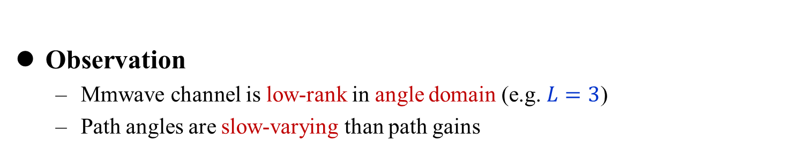
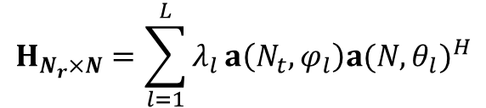
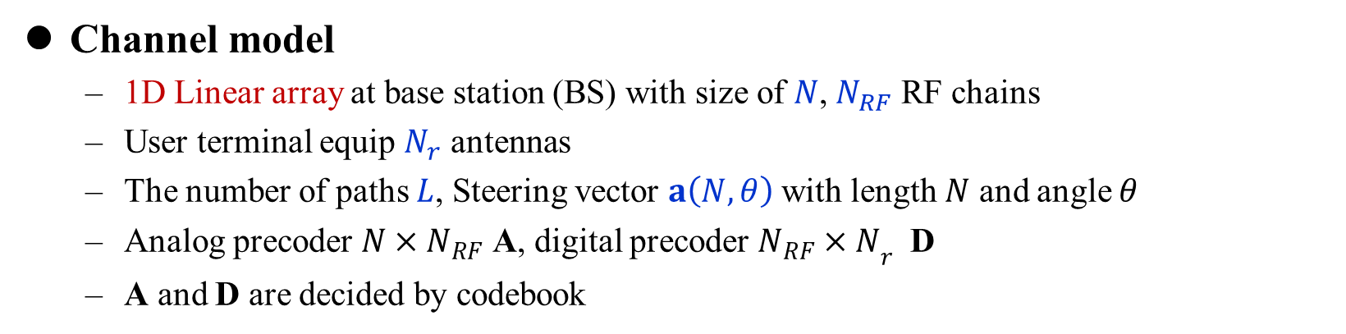
Angle-based codebook
Channel model
  1D Linear array at base station (BS) with size of $N$, $N_{RF}$ RF chains
  User terminal equip $N_{r}$ antennas
  The number of paths $L$, Steering vector $a\left(N,θ\right)$with length $N$ and angle $θ$
  Analog precoder ${N×N}_{RF}$ A, digital precoder ${N_{RF}×N}_{r}$ D
  A and D are decided by codebook
$$H_{N_{r}×N}=\sum_{l=1}^{L}{λ_{l}}a\left(N_{t},φ_{l}\right){a(N,θ_{l})}^{H}$$
Observation
  Mmwave channel is low-rank in angle domain (e.g. $L=3$)
  Path angles are slow-varying than path gains
codebook can be designed based on slow-varying path angles
Notes:
We consider a mmWave massive MIMO system with hybrid precoding. The base station (BS) employs the widely used uniform linear array (ULA) of M antennas and NRF RF chains. The N×1 received signal vector y at the user can be describe as (), among them, A is analog precoder and D is digital precoder, they are decided by codebook. The elements of A are constraint by PSs resolution, for example, 1-bit PS, Aij comes from 1,-1. for the channel matrix H, we adapt the classical ray-based channel model, the channel is combined by several resovable paths. L is the path number ,and a(N,theta) is the steering vector, theta and phi is the path angles at BS and the user and lambda is the path propagation gains. We can observe that the Mmwave channel is low-rank in angle domain (e.g. L=3) and the angles are varying slower than path gains. This is because the path angles is mainly decided by the surrounding scatters around the BS. They do not frequently change their position, So the path angles vary much slower than the path gains. Utilizing this characteristic, the codebook can be designed based on slow-varying path angles.

Slide 8
Angle-based codebook
Main idea
  Analog codeword with array gain very close to steering vectors
  Digital codewords linearly combine analog codewords towards different angles
Analog codewords
  Angle set , is the angle-domain resolution
  steering vector grid
  The array gain of
  The optimal problem can be described as
  Where the elements of with -bit PSs satisfies
Notes:
So, the main idea of our proposed angle-based codebook is,the analog codewords f are with array gain very close to steering vectors and digital codewords linearly combine these analog codewords towards different angles. For the analog codewords, the array gain can be denoted like this. Omiga is angle set on angle domain and delta is the angle-domain interval, then matrix G is composed of steering vectors on each angle in Omiga. The array gain of a steering vector yita is yita=conjugate transpose G multiple a. Therefore for the analog codeword ftheta, the optimal problem is like this. This makes ftheta has the nearest array gain to steering vector a(N,theta) under the PSs constraint as ().

Slide 9
Angle-based codebook
Neighbor search algorithm (NSA)
  Target: find the near-optimal codeword towards the target angle
  Neighbor set: codewords with elements different to
  Procedure:
    Generate reference array gain
    Randomly choose as initial codeword, generate its neighbor set
    Find the optimal codeword in as
Notes:
To solve the optimal problem, we utilize a neighbor search algorithm. The target is to find the near-optimal codeword toward the target angle theta under the PSs constraint and the neighbor set of f is composed of codewords which have D elements different to f. The procedure of NSA is, firstly generate reference array gain, than randomly choose f1 as initial codeword ans generate its neighbor set, find the optimal codeword in neighbor set fi+1. Put it into next iteration. After several iteration, we can find the near-optimal codeword f.

Slide 10
Angle-based codebook
Simulation results
  Parameters:
  Codewords from NSA have equal beam width and near-optimal array gain
  The NSA can apply to low-resolution hybrid precoding (1-3bit PSs)
Optimal steering vector
NSA with 1-bit PSs
Notes:
Some simulation results are given for NSA. The paremeters are theta = pi over 3, N = 64 and D=2. We can see that the codeword from NSA with 1-bit PSs has equal beam width and nearly 70% array gain compared to the ideal steering vector. Also, the NSA can apply to different PS resolutions, such as 2-bit and 3-bit.

Slide 11
Angle-based codebook
Simulation results
  Parameters:
  Codewords from NSA have equal beam width and near-optimal array gain
  The NSA can apply to low-resolution hybrid precoding (1-3bit PSs)
NSA with 2-bit PSs
NSA with 3-bit PSs
Notes:
Some simulation results are given for NSA. The paremeters are theta = pi over 3, N = 64 and D=2. We can see that the codeword from NSA with 1-bit PSs has equal beam width and nearly 70% array gain compared to the ideal steering vector. Also, the NSA can apply to different PS resolutions, such as 2-bit and 3-bit.

Slide 12
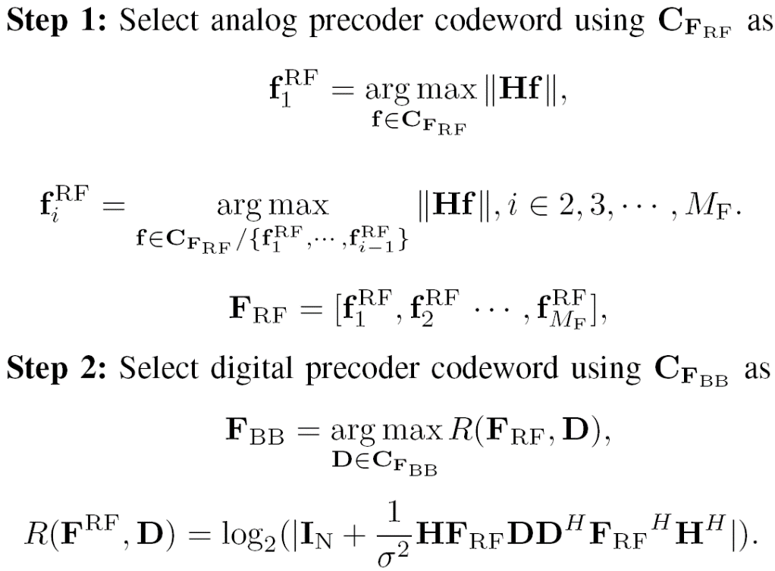
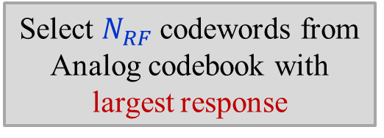
Angle-based codebook
Angle-based hybrid precoding codebook
  Analog codebook: codewords towards different angles, cover angle domain
  Analog codewords come from NSA and constraint by PSs resolution
  Digital codebook employs random vector quantizaiton (RVQ) codebook
Select $N_{RF}$ codewords from Analog codebook with largest response
Select codeword from digital codebook with largest sum-rate
Notes:
Based on the near-optimal codewords towards a specific channel angle, the analog codebook can be designed to include codewords towards different channel angles and unifirmly cover the angle domain. For the digital codebook, we use RVQ codebook to linearly combine the analog part. The codewords can be selected as follow: After the user obtain channel information fron channel estimation, it select $N_{RF}$ codewords from Analog codebook with largest response to compose analog precoder, then select codeword from digital codebook with largest sum-rate. After the analog and digital codewords are picked out at the user, their indexes are fed back to the BS through the uplink channel to directly carry out hybrid precoding.

Slide 13
Contents
1
Technical background
2
Angle-based codebook
3
Performance analysis
4
Simulation results
5
Conclusions
Notes:
The next part is performance analysis

Slide 14
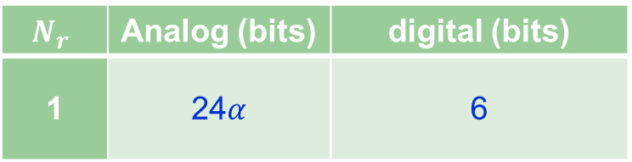
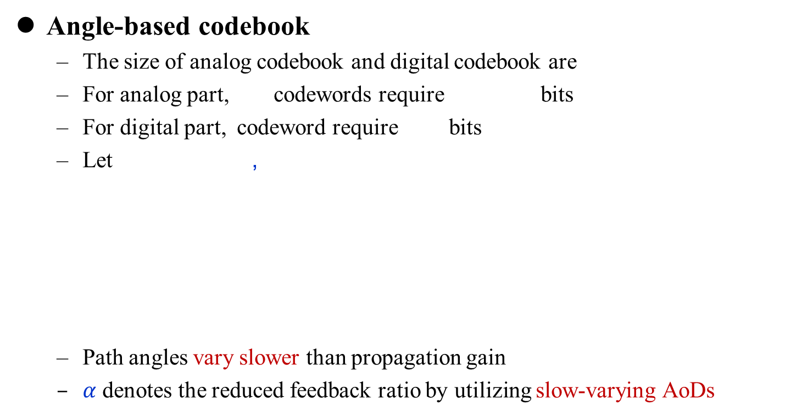






Feedback overhead
Angle-based codebook
  The size of analog codebook and digital codebook are
  For analog part, codewords require bits
  For digital part, codeword require bits
  Let ,
  Path angles vary slower than propagation gain
  $α$ denotes the reduced feedback ratio by utilizing slow-varying AoDs
$$2^{N_{A}},2^{N_{D}}$$
$$N_{RF}$$
$$N_{RF}×N_{A}$$
$$N_{D}$$
$$N_{A}=N_{D}=6$$
$$N_{RF}=4$$
$$N_{r}$$ | Analog (bits) | digital (bits)
1 | 24$α$ | 6
Notes:
The feedback overhead of our proposed angle-based codebook is small. Generally, For analog part,codewords require bitsFor digital part, codewords require bits,The AoDs vary much slower than propagation gains. Considering that the analog codewords are designed to have array gains very close to steering vectors defined by AoDs, the analog codewords selected in (10) will keep unchanged for a much longer time than the digital codeword. Therefore, the average channel feedback overhead is close to ND bits which is much smaller than NRFNA + ND. For example, let Na=Nd=6, the feedback overhead can be reduced by ratio alpha by utilizing the slow-varying AoDs.

Slide 15
Contents
1
Technical background
2
Angle-based codebook
3
Performance analysis
4
Simulation results
5
Conclusions
Notes:
Here is the simulation results.

Slide 16



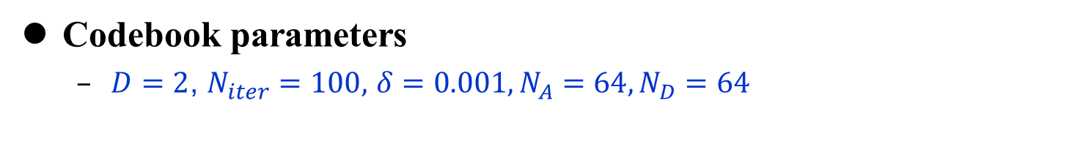

Simulation setup
System parameters
  MIMO configuration:
  1-bit PSs or 2-bit PSs
N $=64,$
$$N_{RF}=4,$$
$$N_{r}=2$$
Channel parameters
  Channel model: Saleh-Valenzuela model
  Scattering paths:
  Antenna array: ULAs at BS and user, with antenna spacing
  Complex gain of each path:
  AoAs/AoDs of each path:
$$L=3$$
Codebook parameters
  $D=2$, $N_{iter}=100,$ $δ=0.001, N_{A}=64, N_{D}=64$
Notes:
The parameters are set like this. We simulate the sum-rate performance for both 1-bit PSs and 2-bit PSs hybrid precoding.

Slide 17
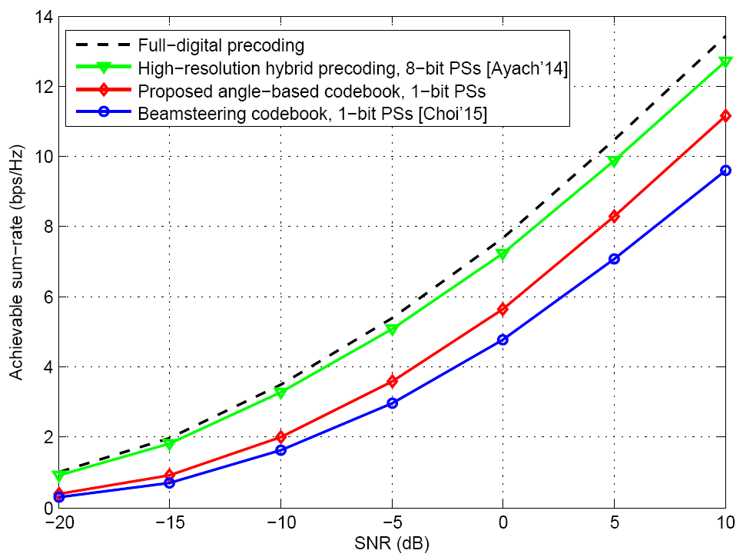
Simulation results
Simulation
[Ayach’14] O. E. Ayach, S. Rajagopal, S. Abu-Surra, Z. Pi, and R. W. Heath, “Spatially sparse precoding in millimeter wave MIMO systems,” IEEE Trans. Wireless Commun., vol. 13, no. 3, pp. 1499–1513, Mar. 2014.
[Choi’15] J. Choi, K. Lee, D. J. Love, T. Kim and R. W. Heath, "Advanced limited feedback designs for FD-MIMO using uniform planar arrays," in Proc. IEEE GLOBECOM’15, San Diego, CA, Dec. 2015, pp. 1-6.
Notes:
This is the sum-rate performance of hybrid precoding with 1-bit PSs . the angle-based codebook outperforms the beamsteering codebook [13]. Moreover, we can observe that the performance gap between angle-based codebook and ideal hybrid precoding is small, e.g. the 1-bit angle-based codebook can achieve 85% sum-rate performance of high-resolution hybrid precoding when SNR = 10.

Slide 18
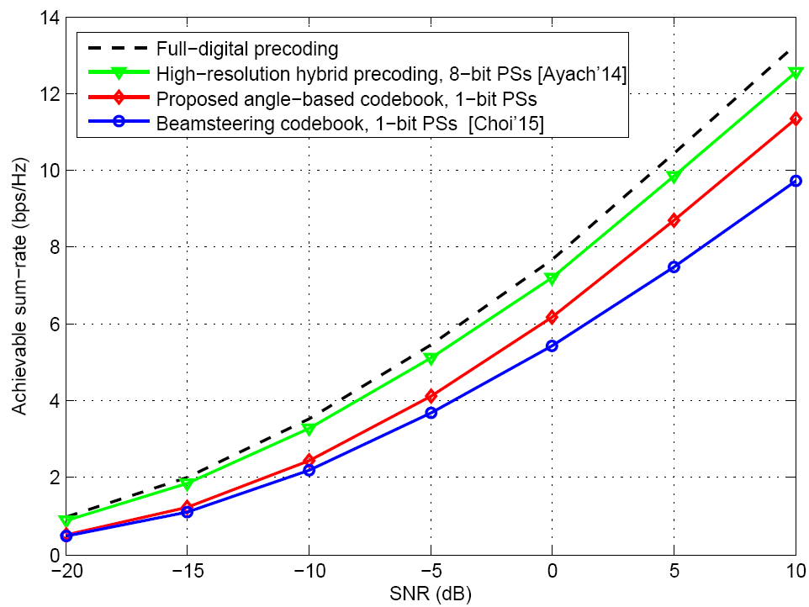
Simulation results
Simulation
[Ayach’14] O. E. Ayach, S. Rajagopal, S. Abu-Surra, Z. Pi, and R. W. Heath, “Spatially sparse precoding in millimeter wave MIMO systems,” IEEE Trans. Wireless Commun., vol. 13, no. 3, pp. 1499–1513, Mar. 2014.
[Choi’15] J. Choi, K. Lee, D. J. Love, T. Kim and R. W. Heath, "Advanced limited feedback designs for FD-MIMO using uniform planar arrays," in Proc. IEEE GLOBECOM’15, San Diego, CA, Dec. 2015, pp. 1-6.
Notes:
This is the sum-rate performance of hybrid precoding with 2-bit PSs

Slide 19
Contents
1
Technical background
2
Angle-based codebook
3
Performance analysis
4
Simulation results
5
Conclusions

Slide 20
Conclusions
Proposed angle-based codebook
  Design a codebook for low-resolution hybrid precoding
  Design the analog codewords based on different angles by NSA
  Utilize RVQ codebook as digital part to combine analog part
  The slow-varying angles can reduce feedback overhead
  Simulation shows angle-based codebook can achieve near-optimal sum-rate
More information
  Our website: http://oa.ee.tsinghua.edu.cn/dailinglong/

Slide 21

Thanks
Reproducible Research: http://oa.ee.tsinghua.edu.cn/dailinglong/

